Slide 1
Heparin Drips
Important Change to RN Heparin Drip Documentation
“Heparin Dose Documentation”

Slide 2
Improvements to RN Heparin Drip Documentation
Brief
Know about changes to Heparin documentation screens
Know when in the process to bring in a second nurse for verification and what both nurses review together
Know how to review Heparin dose changes

Slide 3
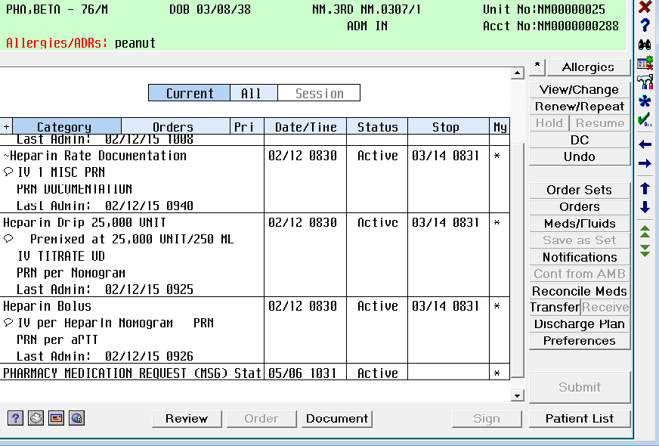
Screenshot from Orders Tab
DOCUMENTATION
Bag
Bolus
Notes:
“Heparin Rate Change” to “Heparin Dose Documentation”
NEED TO CHANGE TO DOSE

Slide 4
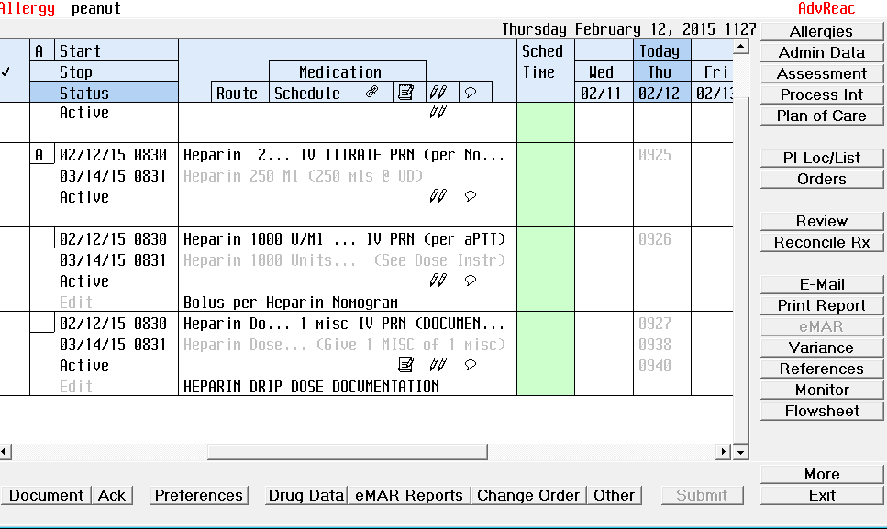
New Look from eMAR
Bag
Bolus
DOCUMENTATION
Notes:
The look from eMAR has different wording but the same 3 functional areas are present.

Slide 5
Where is my nomogram?
Bring in 2nd RN Now!
Notes:
THIS is where the 2nd RN needs to be at the bedside with you.

Slide 6
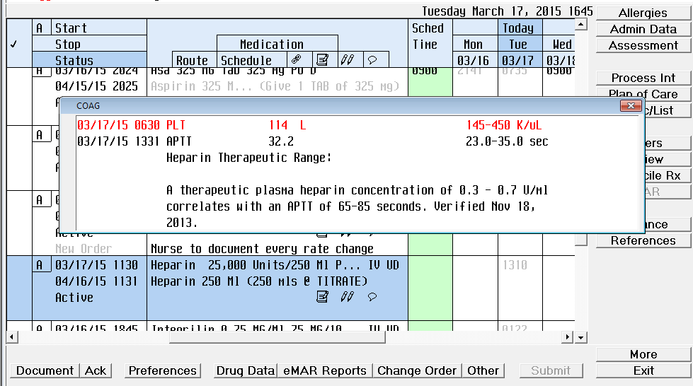
How to document
Scan Label
aPTT results here for 2nd RN Verification
Notes:
No need to go to another screen or area to look for aPTT results.

Slide 7
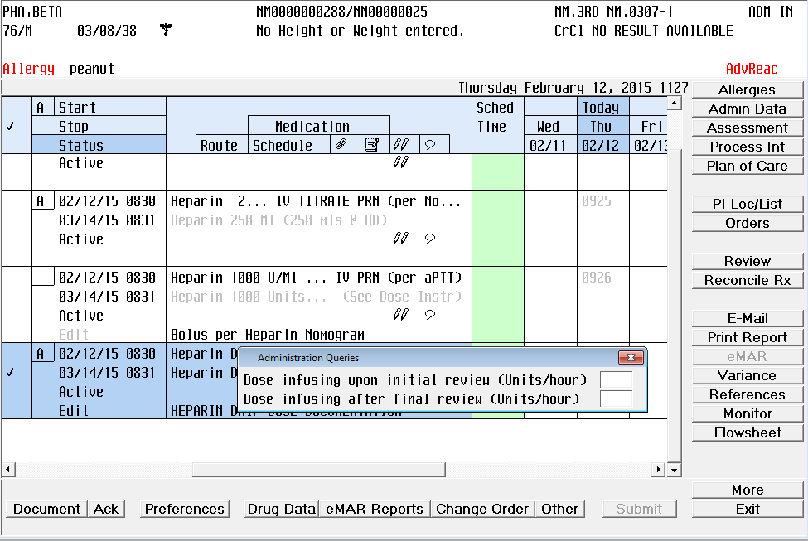
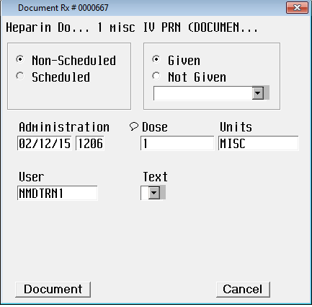
Notes:
NO changes needed to this box

Slide 8
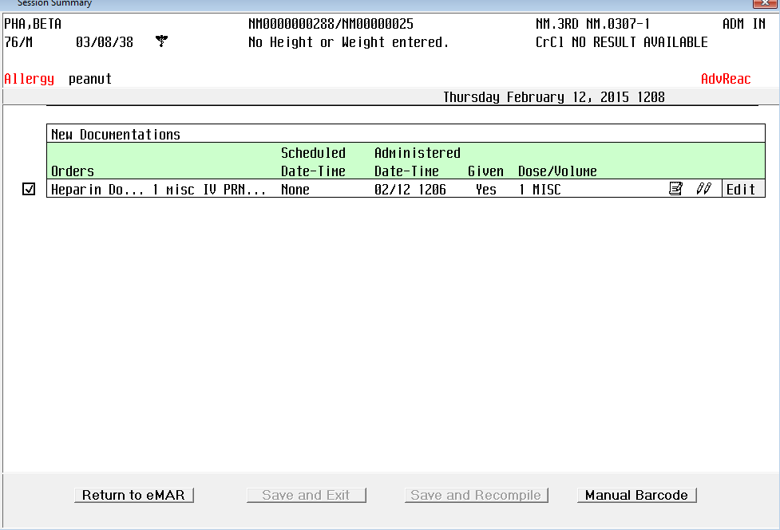
Now we are ready to scan the patient

Slide 9
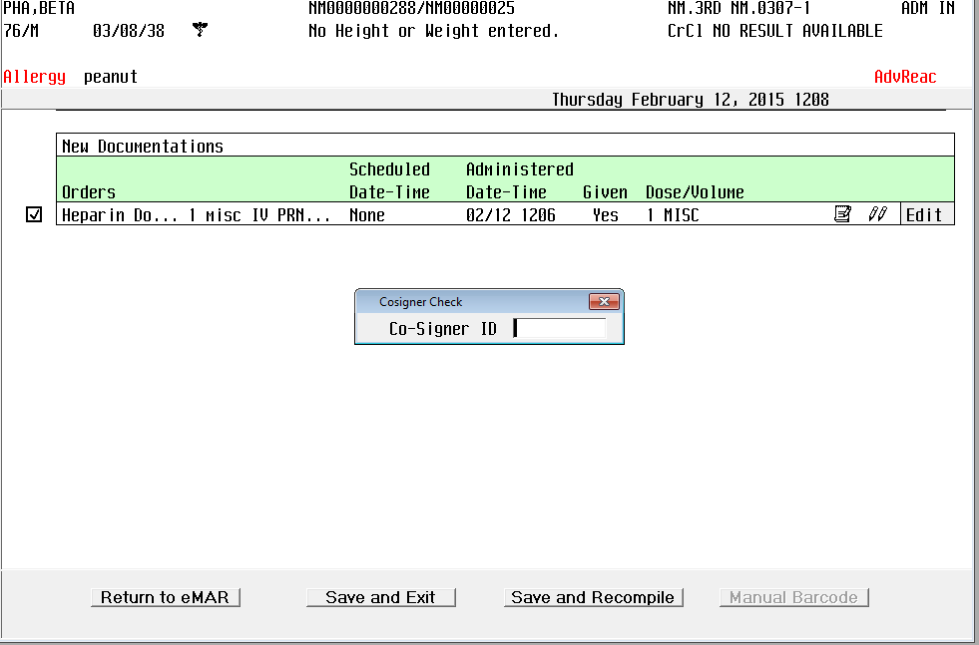
Remember your co-signer.
The 2nd RN should type in their own ID.

Slide 10
3 things needed
Actual bag
Bolus
DOCUMENTATION

Slide 11
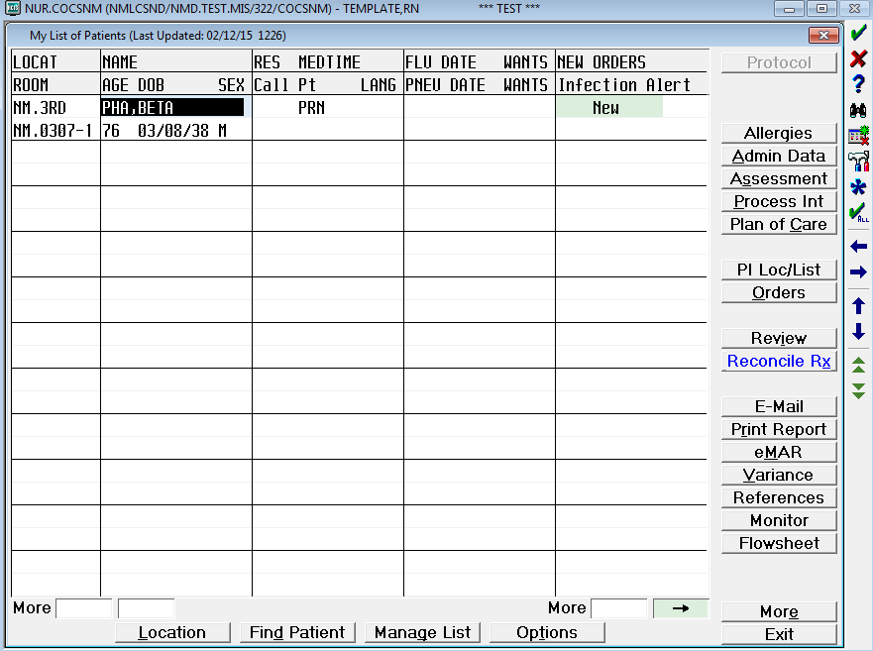
What has been going on with my patient? How to review documentation
Go to orders

Slide 12
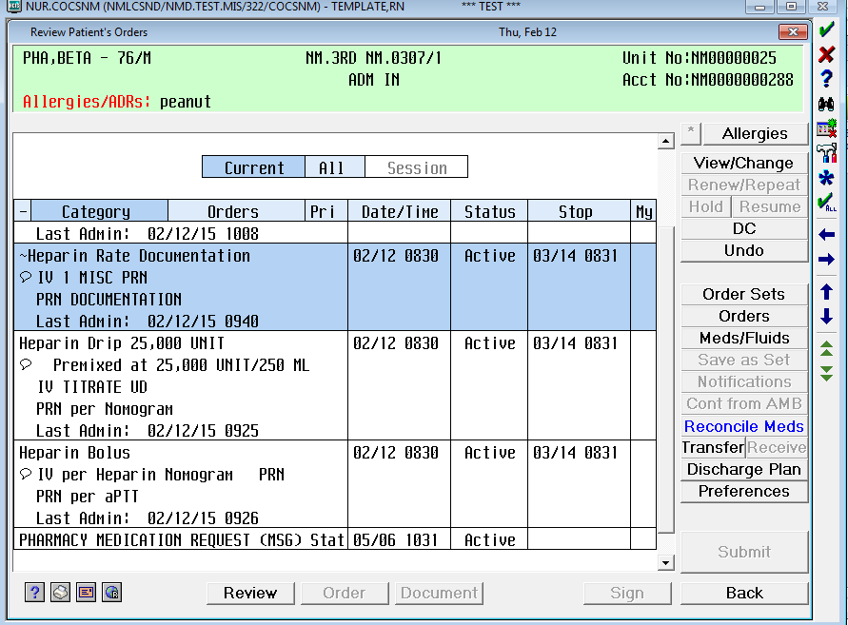
click
Select medication

Slide 13
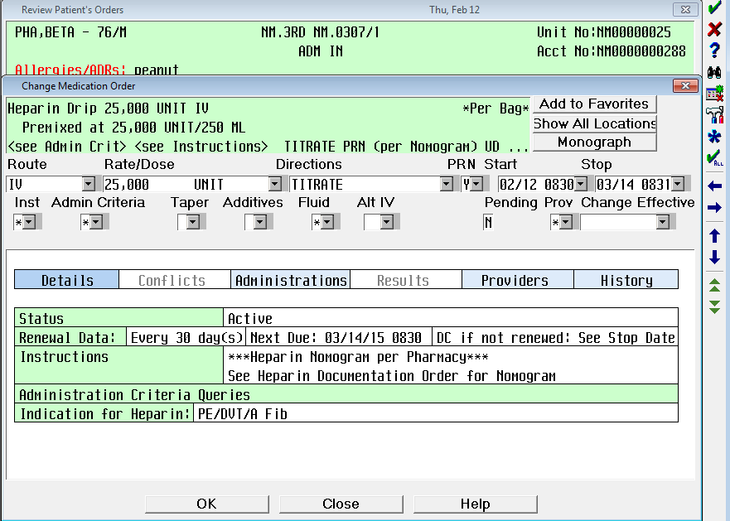
click

Slide 14
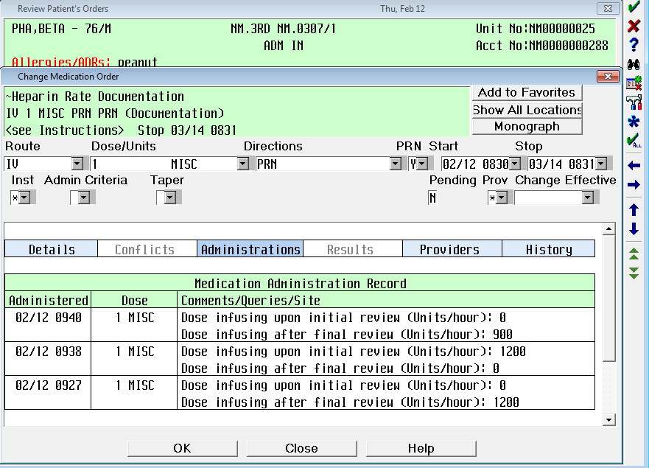
This is why it is IMPORTANT to document changes

Slide 15
Improvements to RN Heparin Drip Documentation
De-Brief
Do you know about changes to Heparin documentation screens?
Do you know when in the process to bring in a second nurse for verification and what both nurses review together?
Do you know how to review Heparin dose changes?

Slide 16
Questions? Concerns?
We appreciate all the work you are doing to improve patient safety

